Slide 1

Title slide + image
Investigating population dynamics with Cellular Automata
Cesar Hernando | Arturo Gallardo | Tim Neumann

Slide 2
Outline
Introduction
Lotka-Volterra (LV) model: Analytical solution of exponential + logistic model
Cellular Automata (CA) simulation: Energy-based model
Mapping from exponential LV model to probabilistic CA
Conclusion

Slide 3
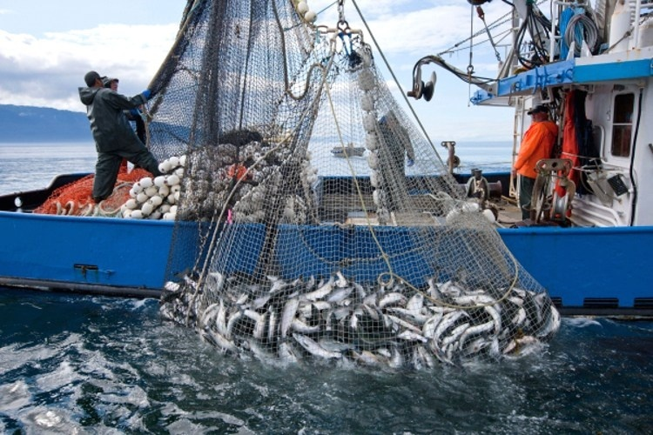
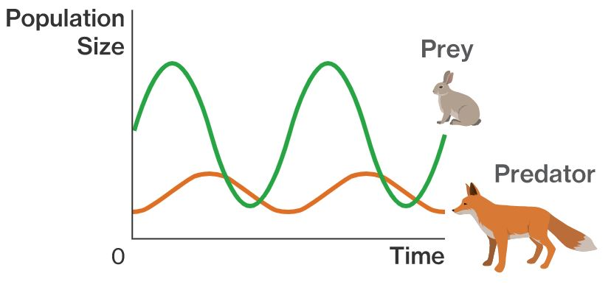
1. Introduction
Ecological systems are complex, but insight into their dynamics is crucial
Weather forecasting and climate change
Protection of natural diversity
Economic considerations
Goal: Understand dynamics of simple system via two different perspectives
Analytical models using differential equations
Numerical models simulating species interaction
Source: NOAA Fisheries, 2022 Available at: https://www.fisheries.noaa.gov/feature-story/new-indicators-could-help-manage-global-overfishing
Source: Predator-prey models to model users, Medium, 2020. Available at: https://medium.com/hello-cdo/predator-prey-models-to-model-users-9ed717fa548f

Slide 4
Outline
Introduction
Lotka-Volterra (LV) model: Analytical solution of exponential + logistic model
Cellular Automata (CA) simulation: Energy-based model
Mapping from exponential LV model to probabilistic CA
Conclusion

Slide 5
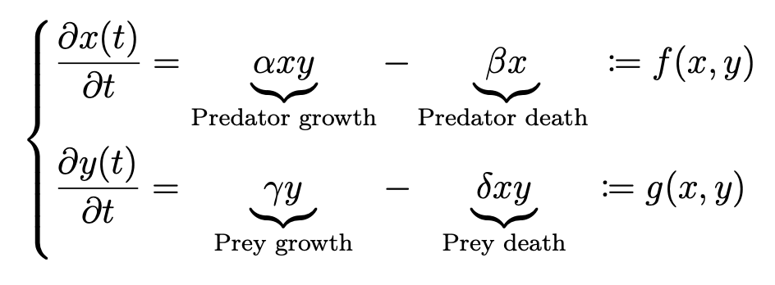
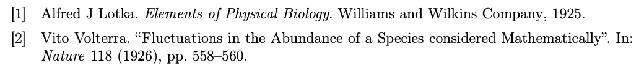
2.0 Lotka-Volterra (LV) model
Pair of first-order (nonlinear) differential equations to describe population dynamics in predator-prey systems
Multiple variations exists, e.g., featuring exponential or logistic prey growth

Slide 6
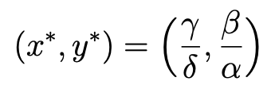
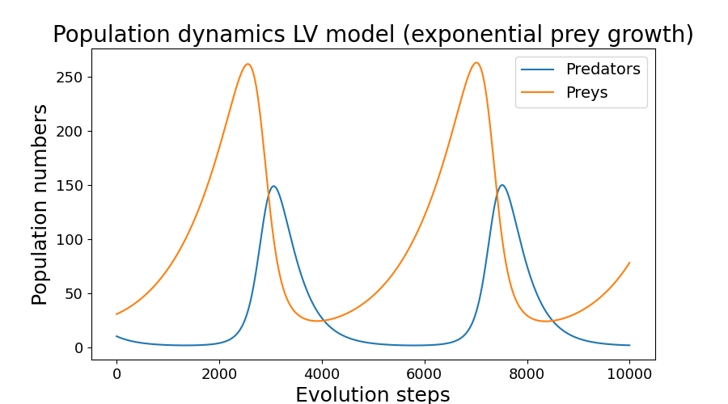
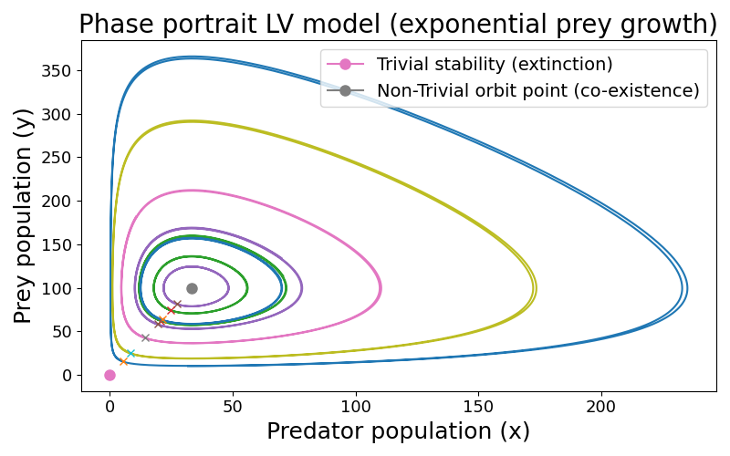
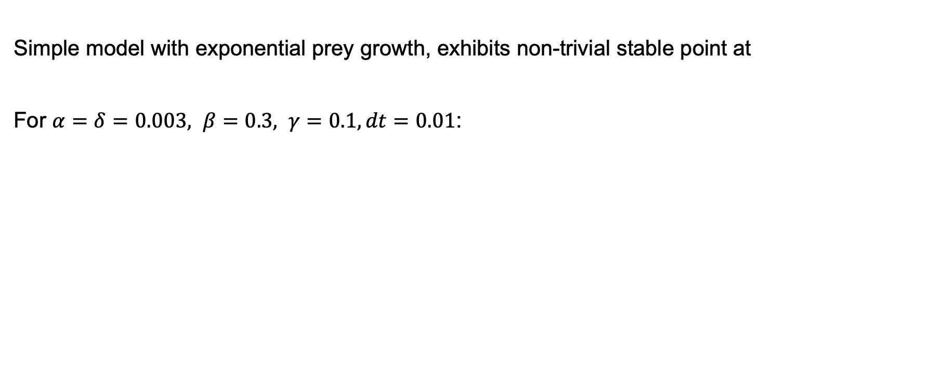
2.1 Exponential LV model
Simple model with exponential prey growth, exhibits non-trivial stable point at
For $α=δ=0.003, β=0.3, γ=0.1, dt=0.01$:

Slide 7
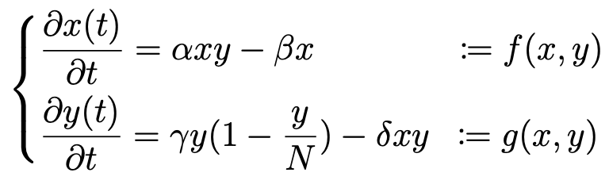
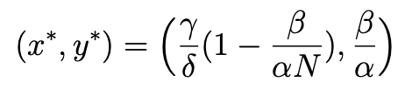
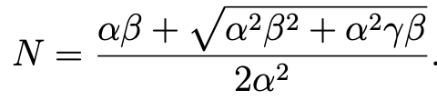
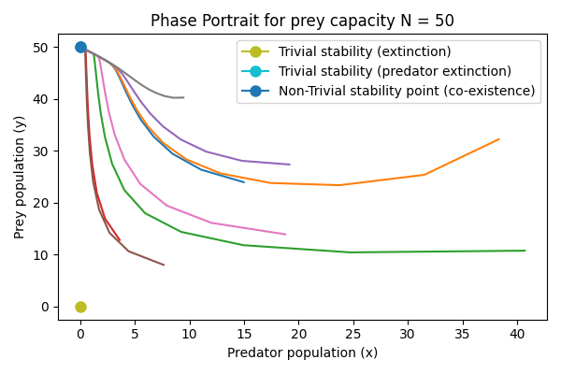
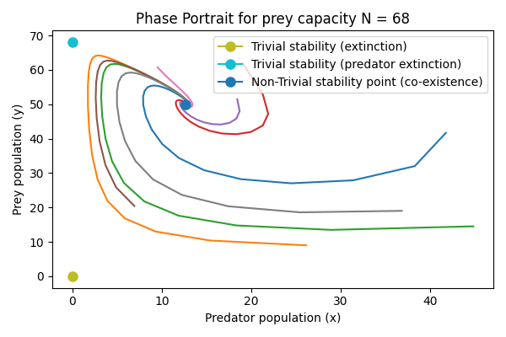
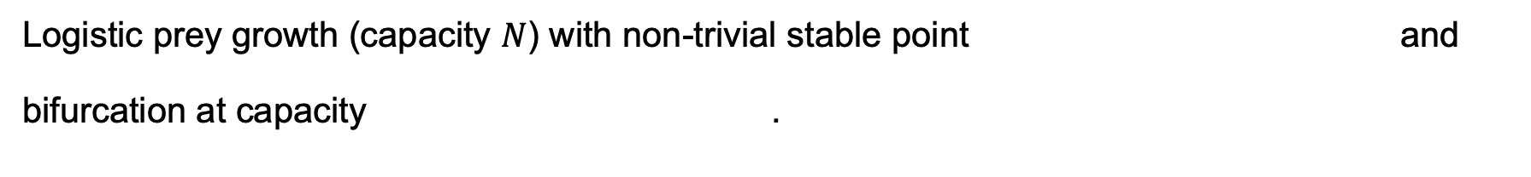
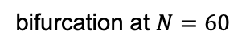
2.2 Logistic LV model
Logistic prey growth (capacity $N$) with non-trivial stable point and
bifurcation at capacity .
For $α=δ=1, β=50, γ=48, dt=0.01:$
bifurcation at $N=60$

Slide 8
Outline
Introduction
Lotka-Volterra (LV) model: Analytical solution of exponential + logistic model
Cellular Automata (CA) simulation: Energy-based model
Mapping from exponential LV model to probabilistic CA
Conclusion

Slide 9
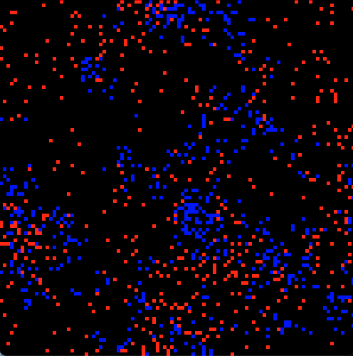
2.3 Population dynamics: Beyond the LV model
Numerical simulation replicates analytical model, but is restricted in expressivity
We want a more realistic simulation: Cellular Automata (CA)
CAs are computational models to simulate the behaviour of complex systems:
Grid of cells with finite number of states
Discrete update rules (can be deterministic or probabilistic) to define system evolution
Locality due to neighbor interactions
Useful for our goal to simulate realistic predator-prey systems

Slide 10
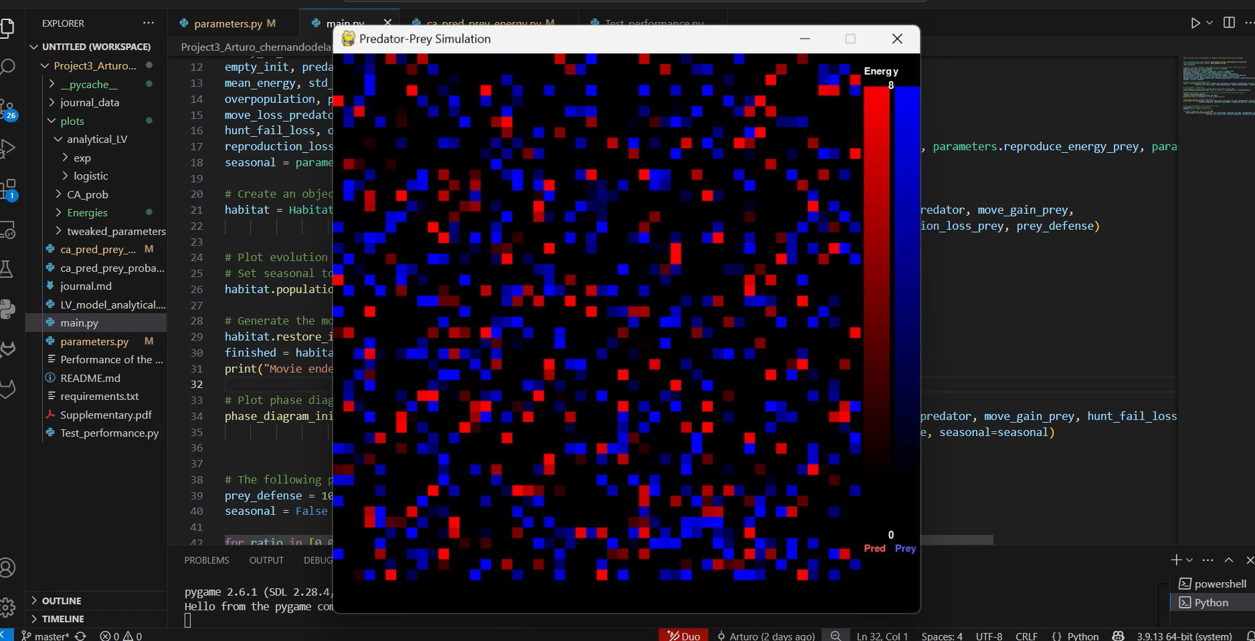
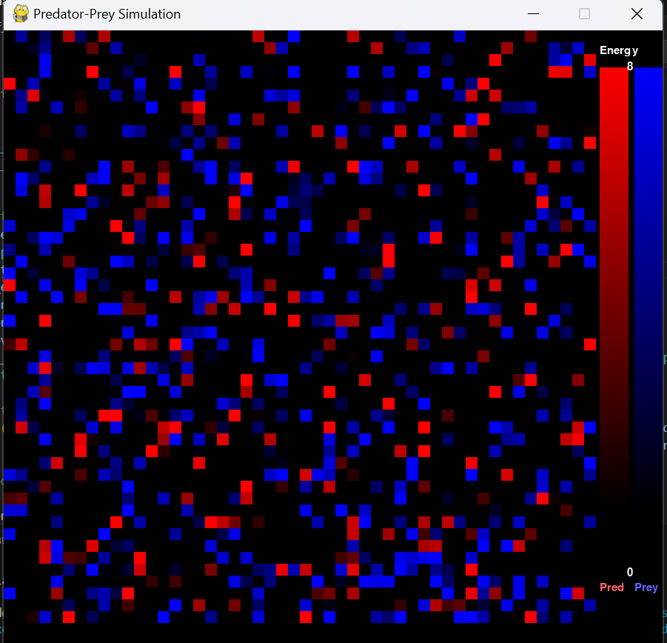
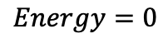
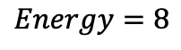
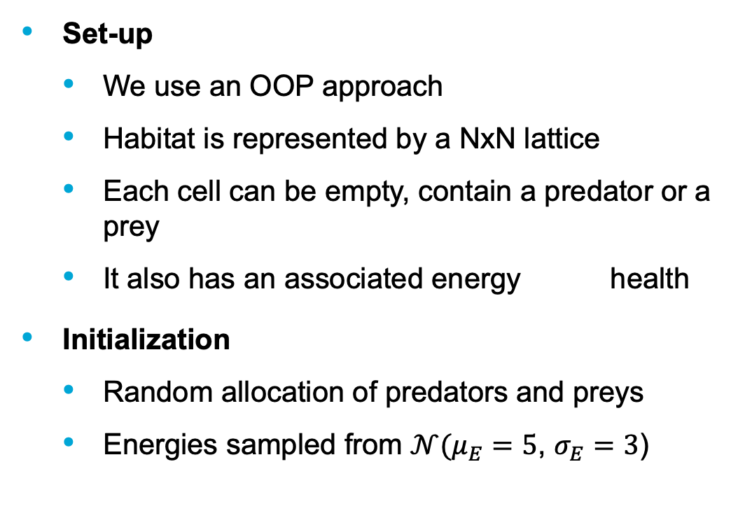
3.1. Energy-based CA: Set-up and initialization
70% empty cells, 10% predators, 20% preys
Set-up
We use an OOP approach
Habitat is represented by a NxN lattice
Each cell can be empty, contain a predator or a prey
It also has an associated energy health
Initialization
Random allocation of predators and preys
Energies sampled from $𝒩(μ_{E}=5$, $σ_{E}=3$)
$$Energy=8$$
$$Energy=0$$
Predator
Prey

Slide 11
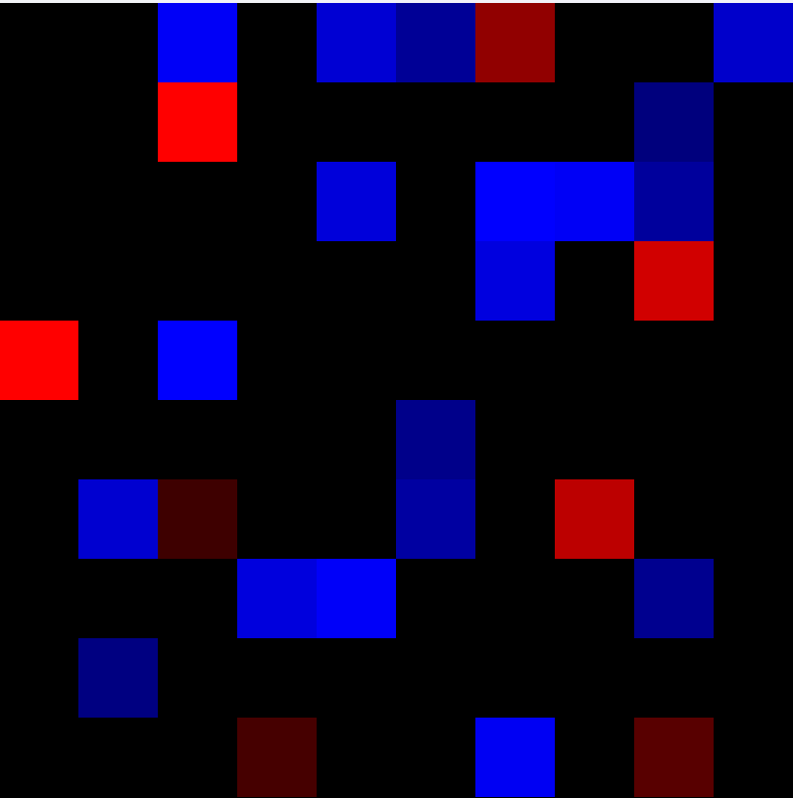
3.2. Energy-based CA: Evolution rules
At each evolution step, the order in which cells act is randomized
Animals act based on the current state of the lattice, which is updated immediately after each individual acts.
Periodic boundary conditions are used to determine each cell’s neighbors.
Implement a set of action rules to simulate real ecosystem interactions
Separate action rules for predators and prey

Slide 12
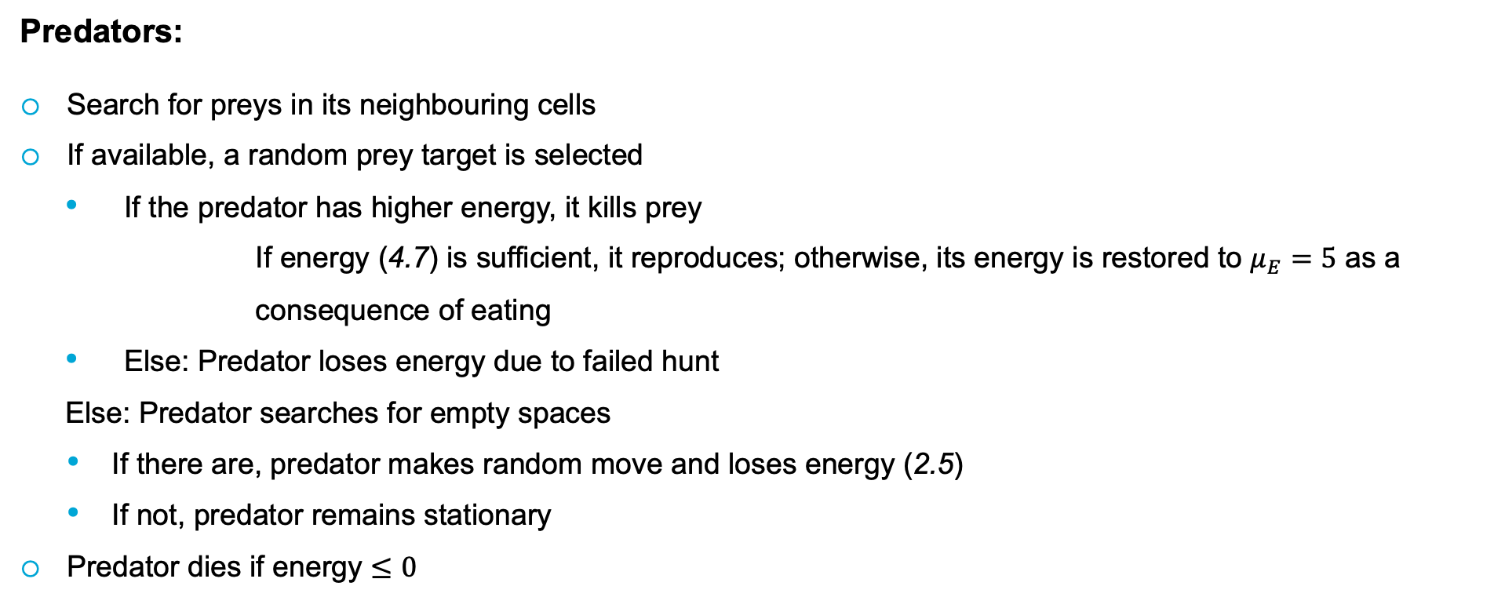
3.2. Energy-based CA: Evolution rules
Predators:
Search for preys in its neighbouring cells
If available, a random prey target is selected
If the predator has higher energy, it kills prey
If energy (4.7) is sufficient, it reproduces; otherwise, its energy is restored to $μ_{E}=5$ as a
consequence of eating
Else: Predator loses energy due to failed hunt
Else: Predator searches for empty spaces
If there are, predator makes random move and loses energy (2.5)
If not, predator remains stationary
Predator dies if energy $≤0$

Slide 13
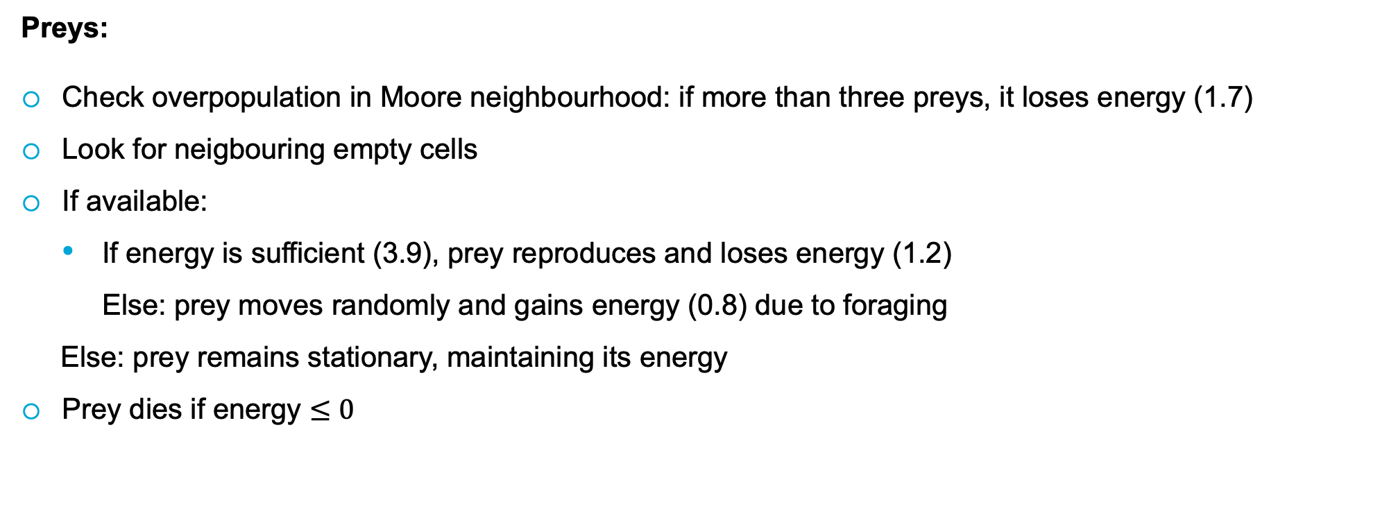
3.2. Energy-based CA: Evolution rules
Preys:
Check overpopulation in Moore neighbourhood: if more than three preys, it loses energy (1.7)
Look for neigbouring empty cells
If available:
If energy is sufficient (3.9), prey reproduces and loses energy (1.2)
Else: prey moves randomly and gains energy (0.8) due to foraging
Else: prey remains stationary, maintaining its energy
Prey dies if energy $≤0$

Slide 14
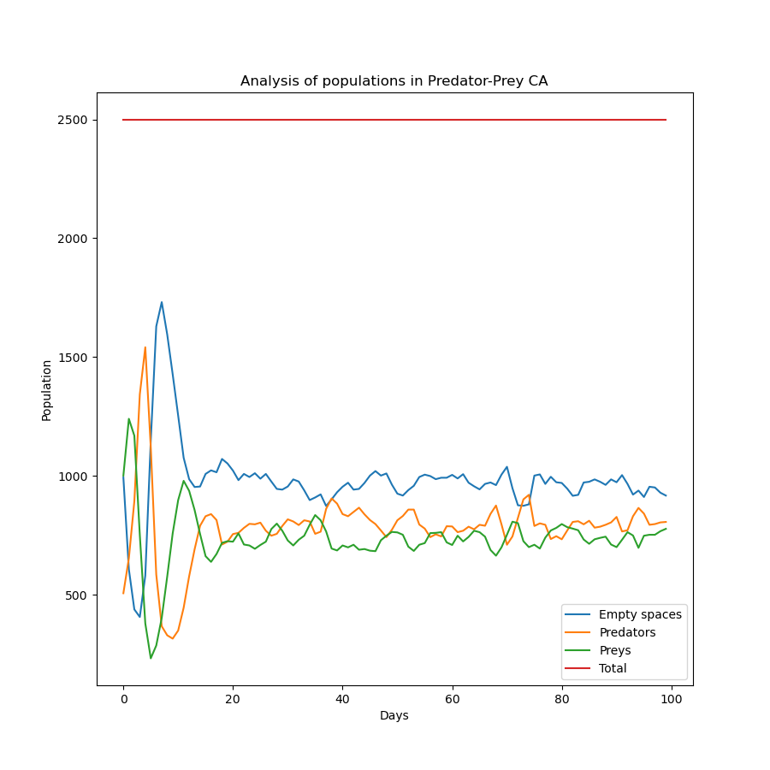
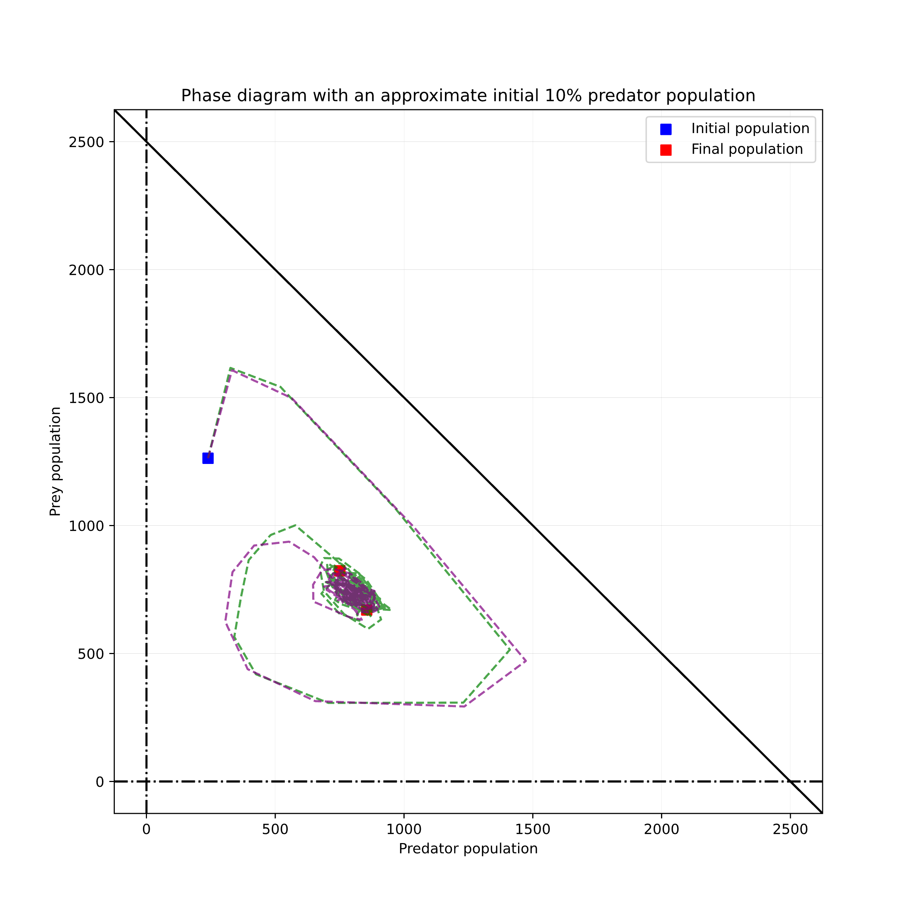
3.3 Balanced evolution (No seasons, no prey defence)

Slide 15
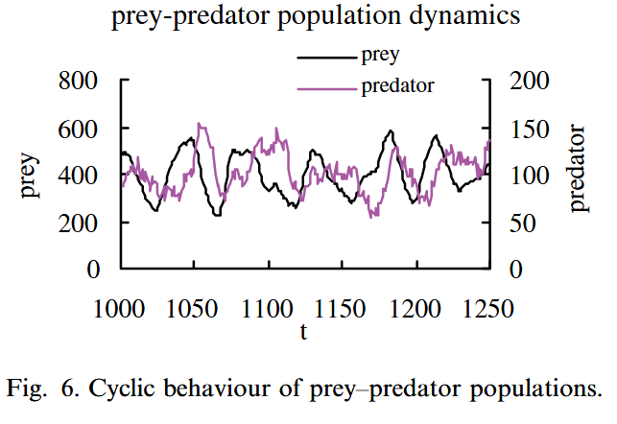
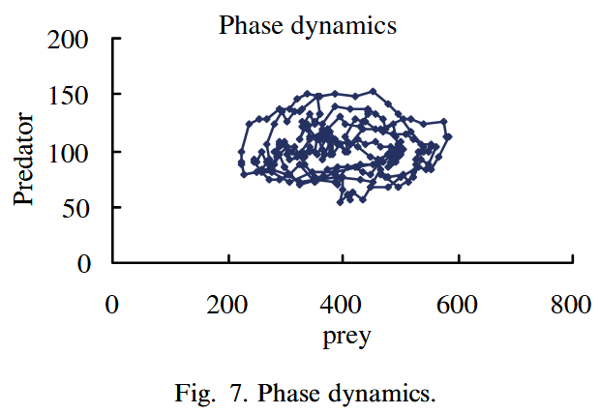
3.3 Balanced evolution (No seasons, no prey defence)
[4] Q. Chen and A.E. Mynett. “Effects of cell size and configuration in cellular automata based prey–predator modelling”. In: Simulation Modelling Practice and Theory 11.7 (2003), pp. 609– 625. issn: 1569-190X. doi: https://doi.org/10.1016/j.simpat.2003.08.006.
[5] Q. et al. Chen. “Stability Analysis of Harvesting Strategies in a Cellular Automata Based Predator-Prey Model”. In: Cellular Automata. Springer Berlin, Heidelberg, 2006. isbn: 978- 3-540-40929-8.

Slide 16
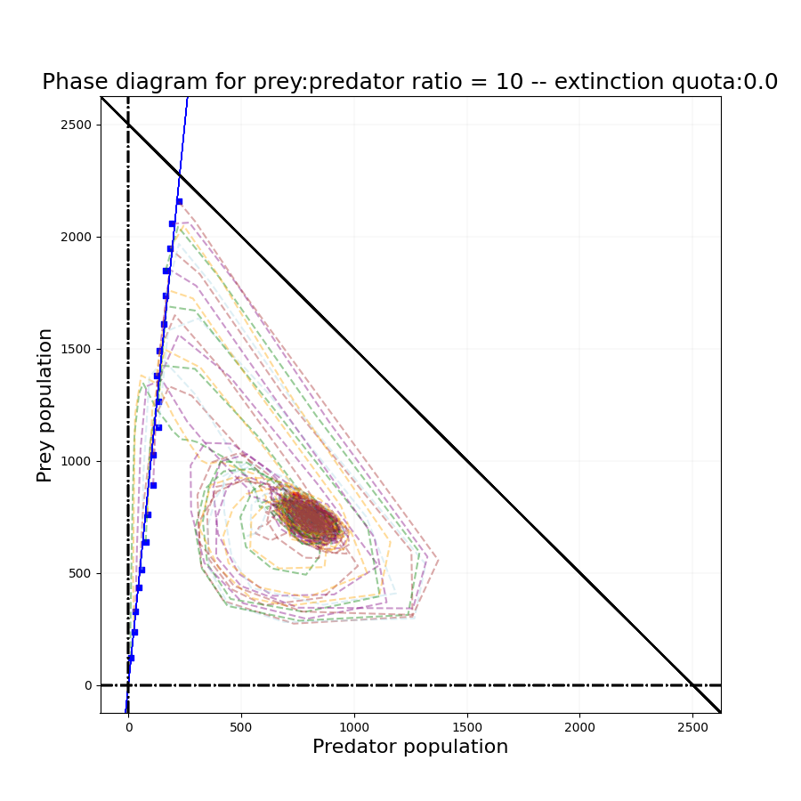
3.4 Stability analysis

Slide 17
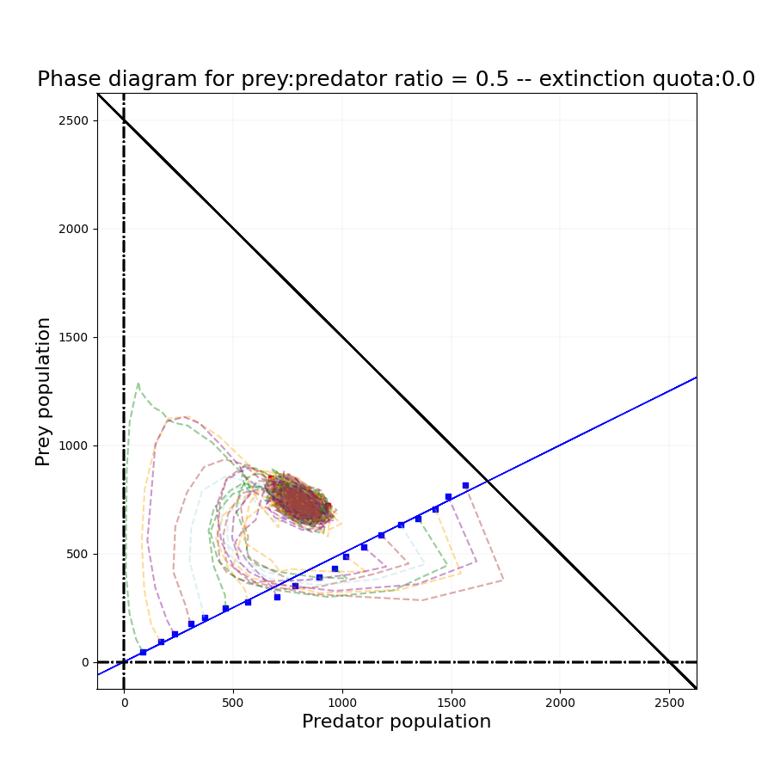
3.4 Stability analysis

Slide 18
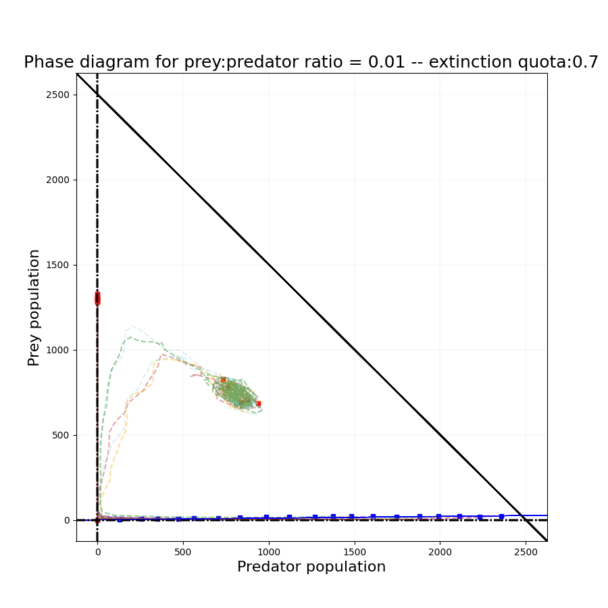
3.4 Stability analysis
70% of the cases are ending in extinction

Slide 19
3.5 Fishing extinction?
Energy-based CA model can potentially simulate species extinction by human fishing
But our model is not well fitted for fishing:
Humans can hunt or fish more than one prey
Humans are not dependent on a single energy source
Displacement beyond neighbouring cells
[6] Milner B. Schaefer. “Some aspects of the dynamics of populations important to the management of the commercial marine fisheries”. In: Bulletin of Mathematical Biology 53.1 (1991), pp. 253–279. issn: 0092-8240. doi: https://doi.org/10.1016/S0092-8240(05)80049-7. url: https://www.sciencedirect.com/science/article/pii/S0092824005800497.

Slide 20
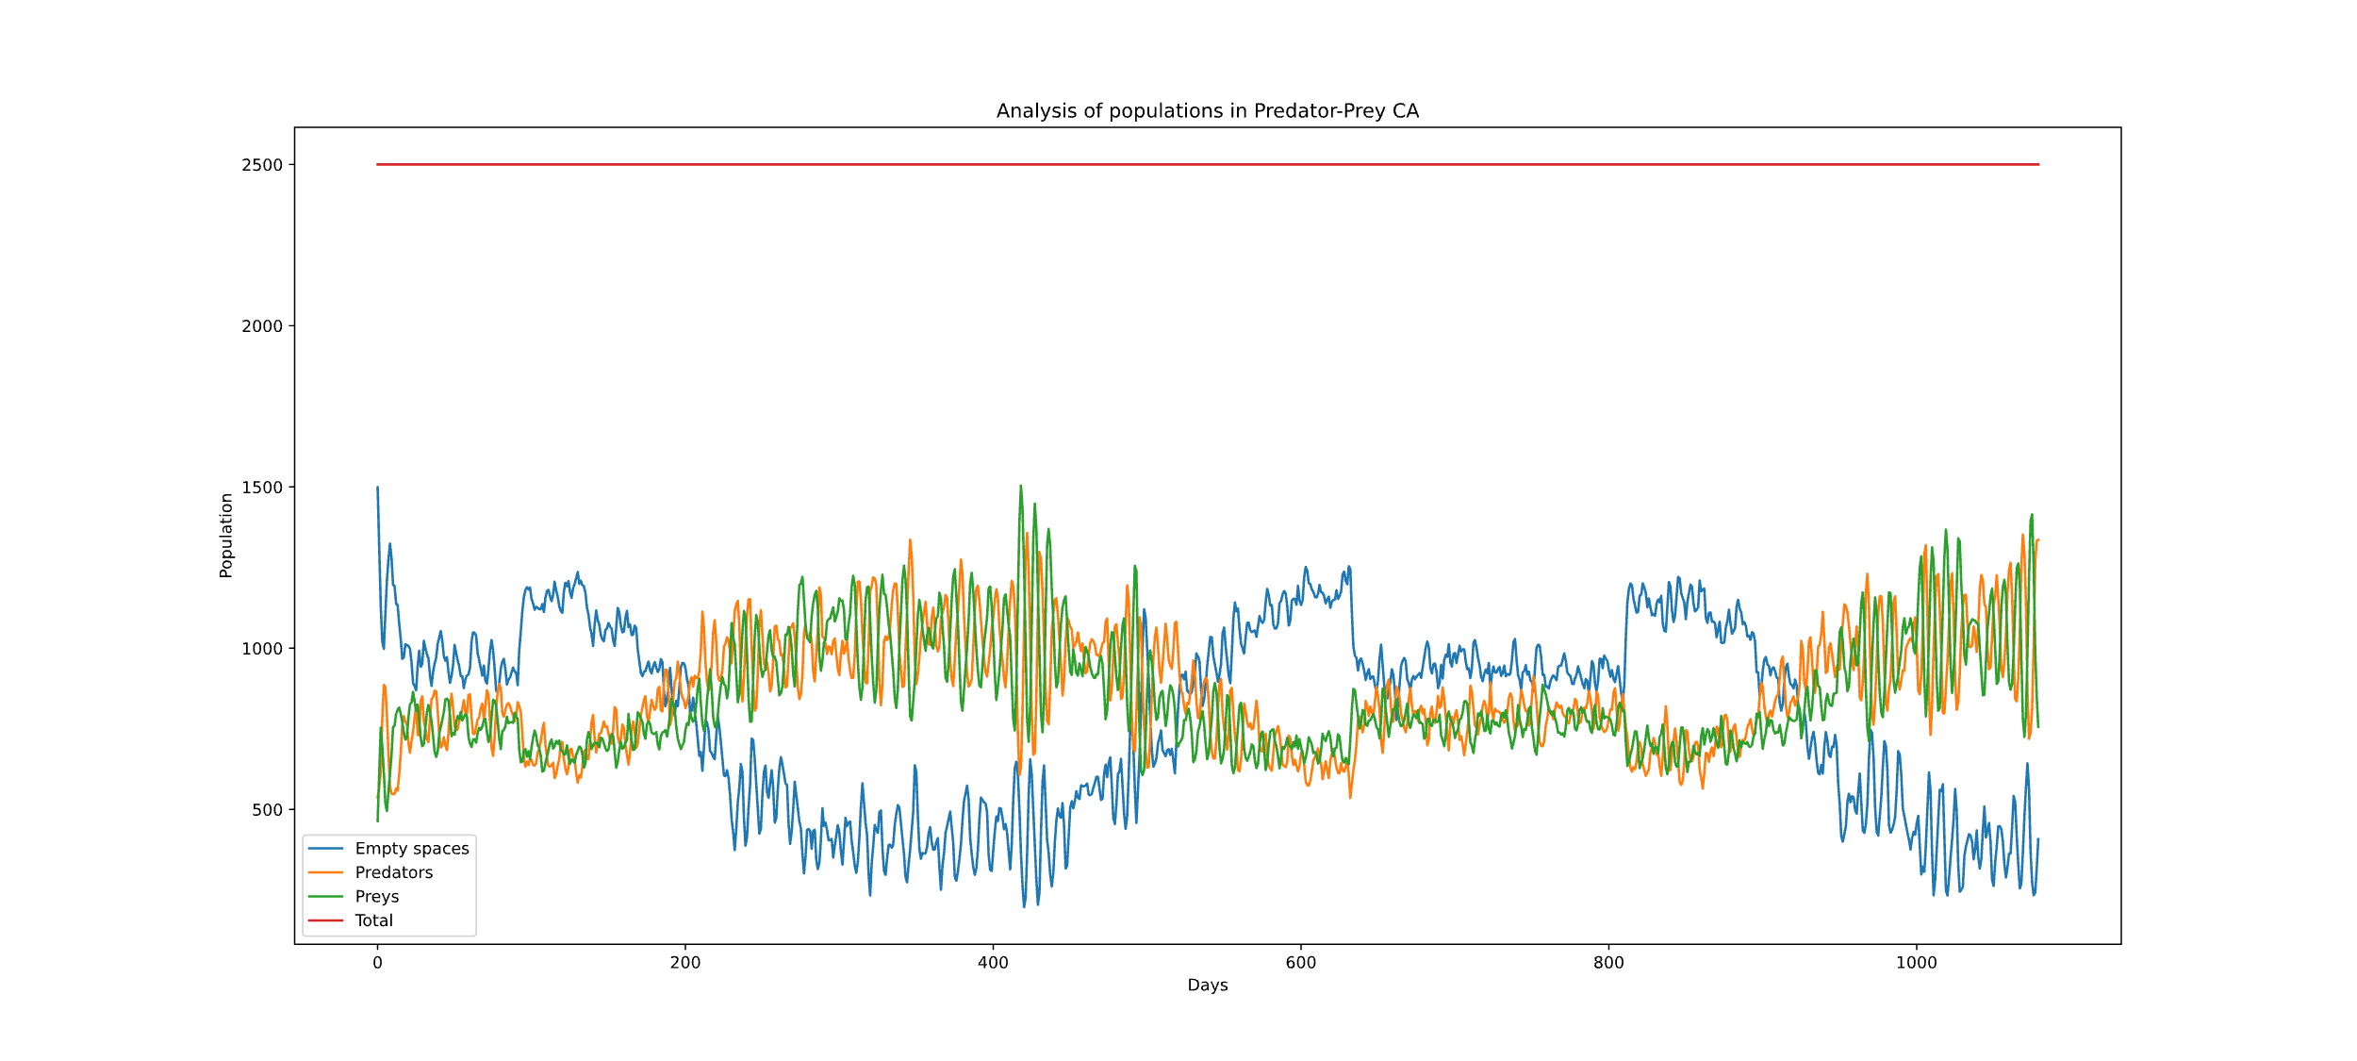
3.6 Seasonal oscillations (No defence)
Seasons are modelled with a cosine: energy gain and losses vary in time

Slide 21
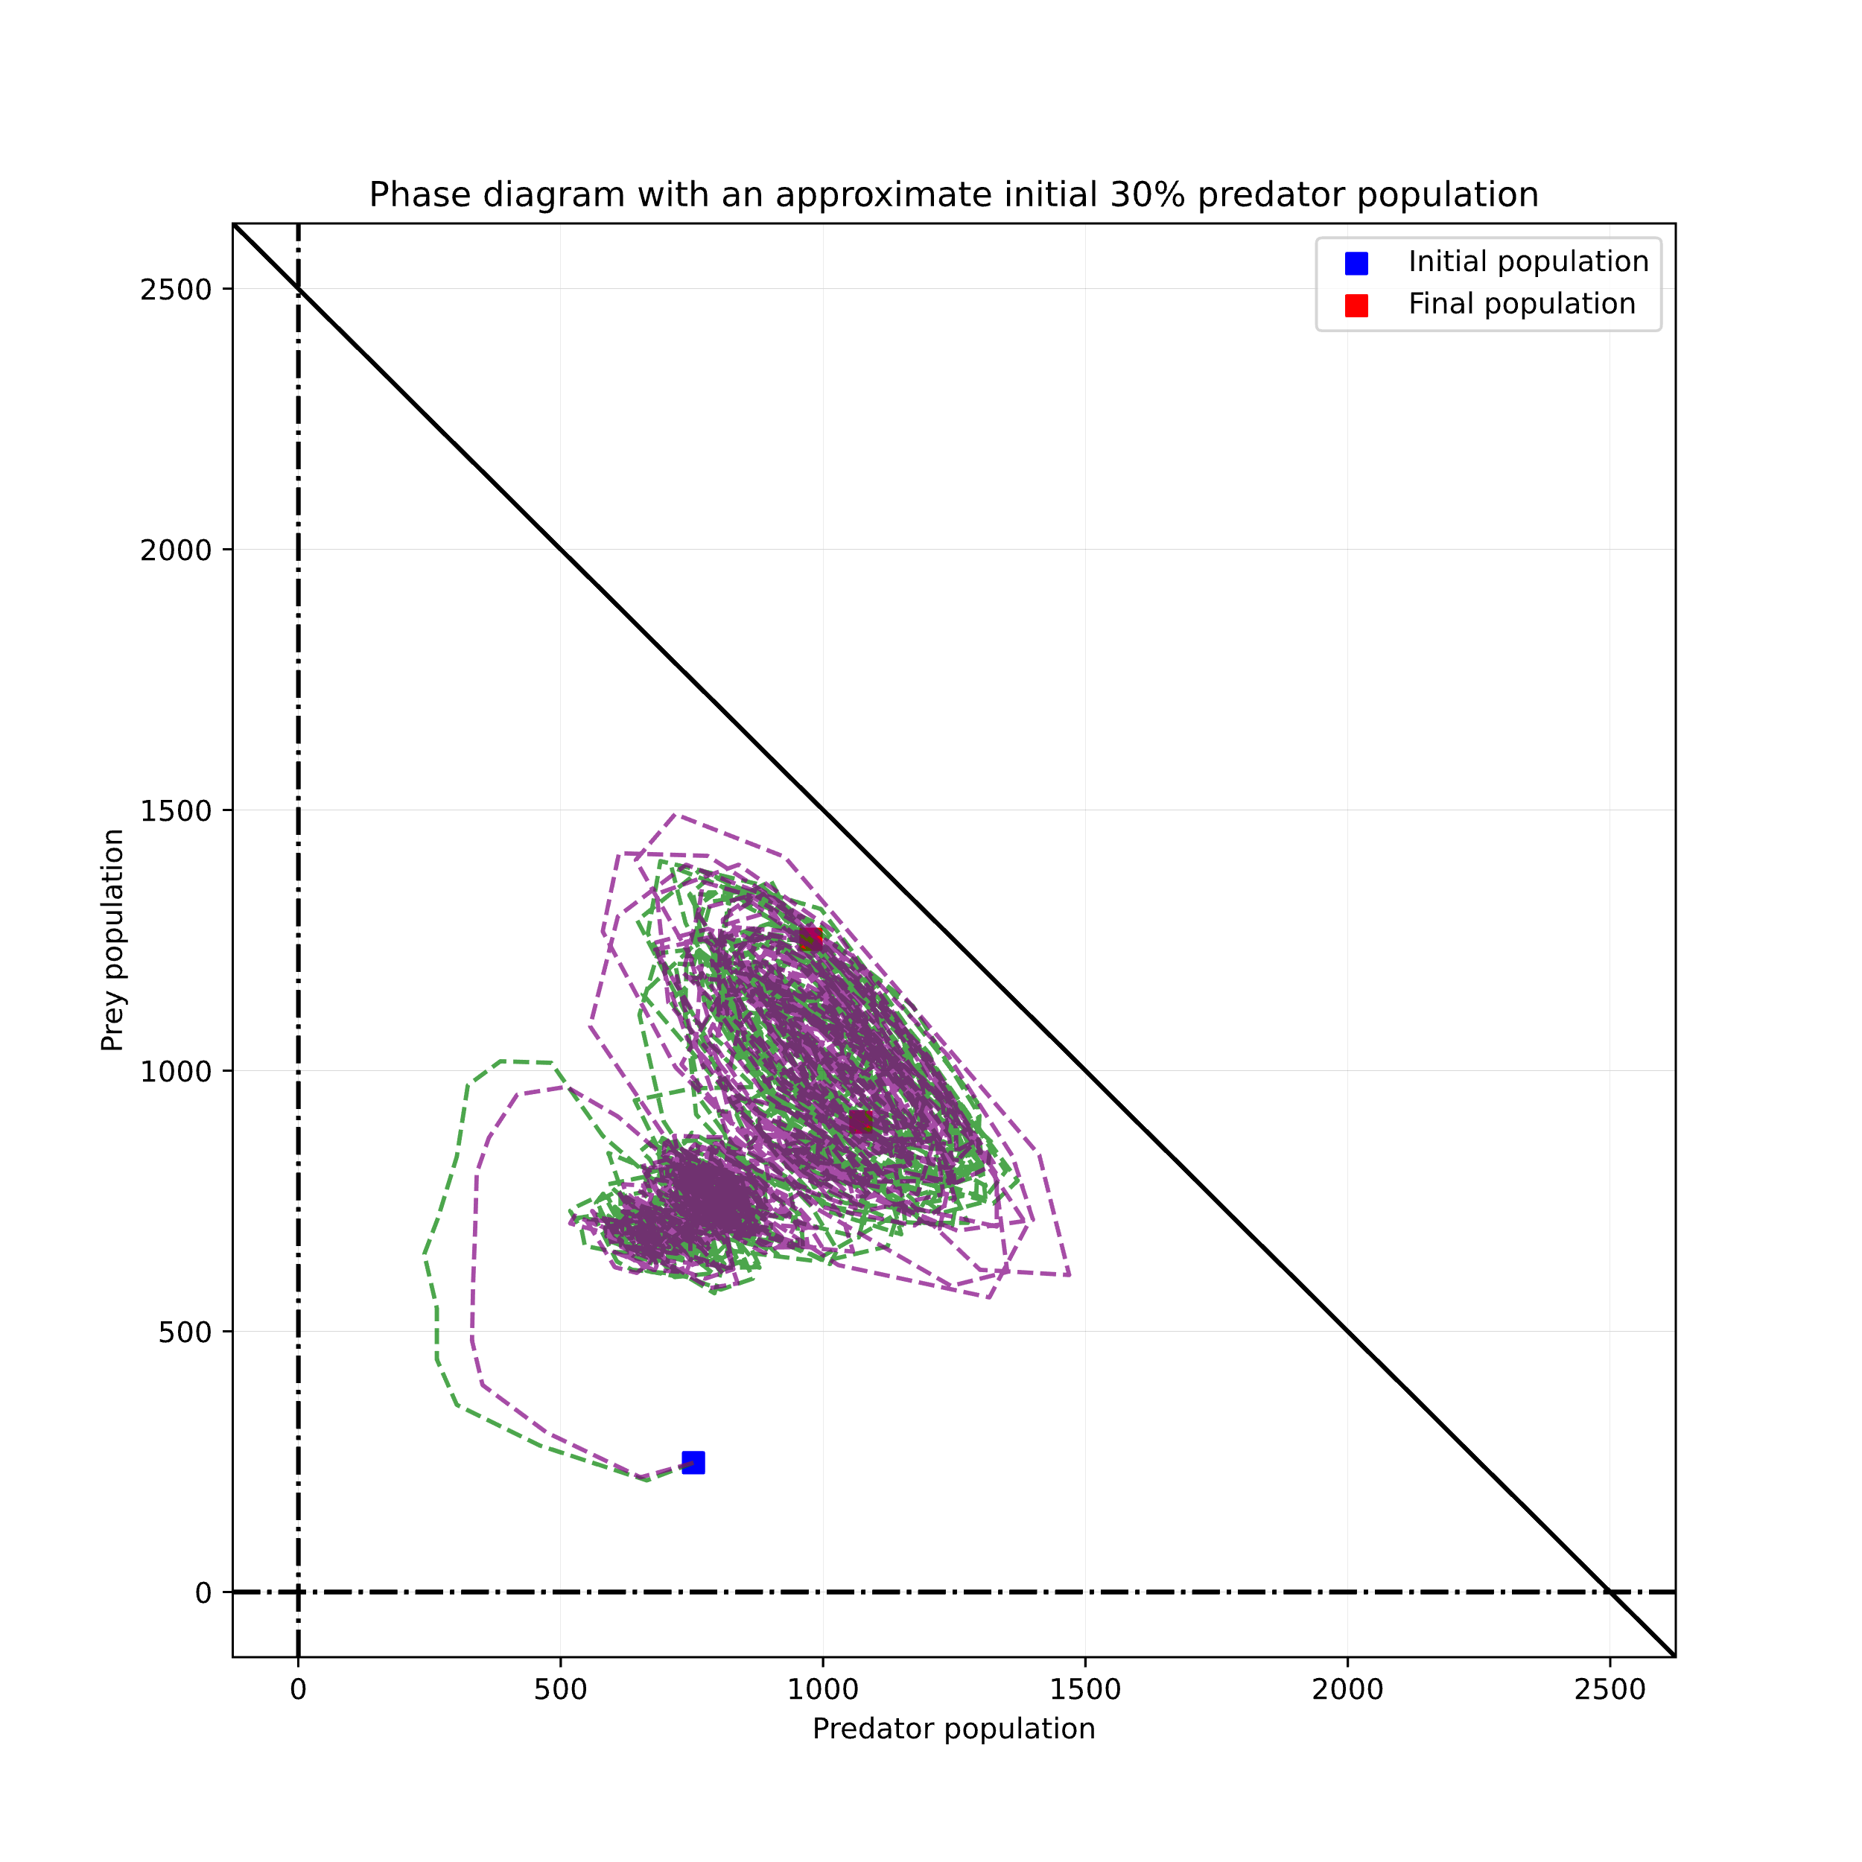
3.6 Seasonal oscillations (No defence)
Formation of two stable points

Slide 22
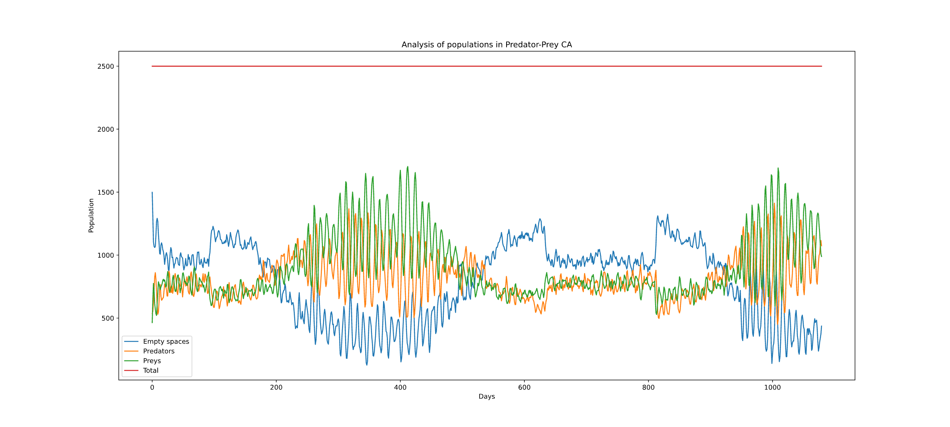
3.7 Prey defence (with seasons)
If predator has at least six prey in its surrounding, it cannot hunt

Slide 23
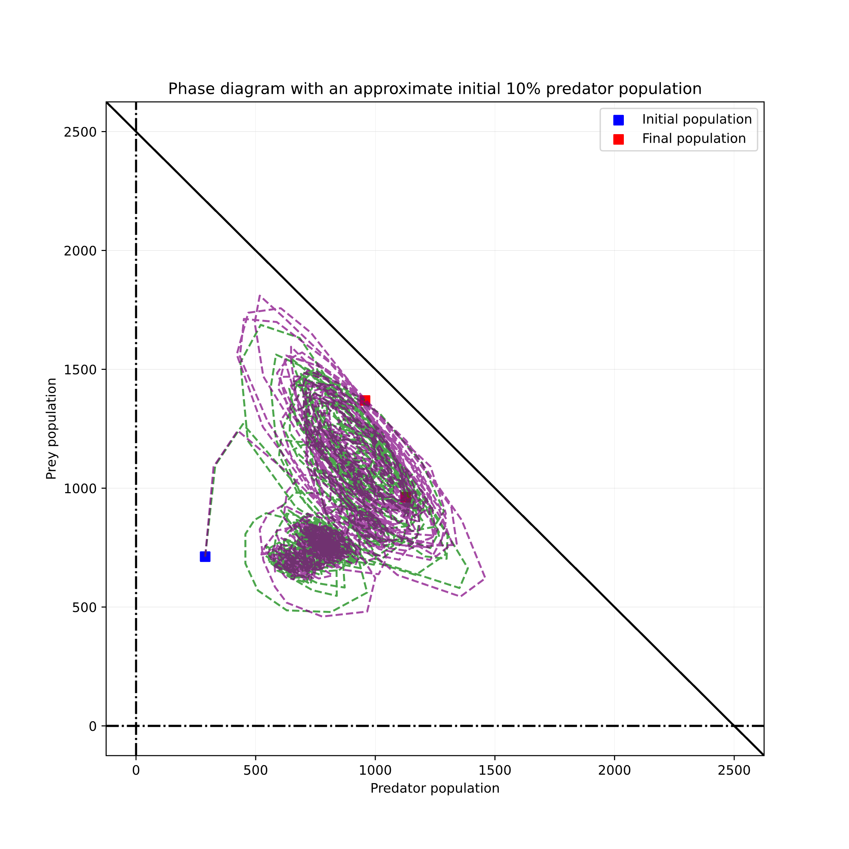
3.7 Prey defence (with seasons)

Slide 24
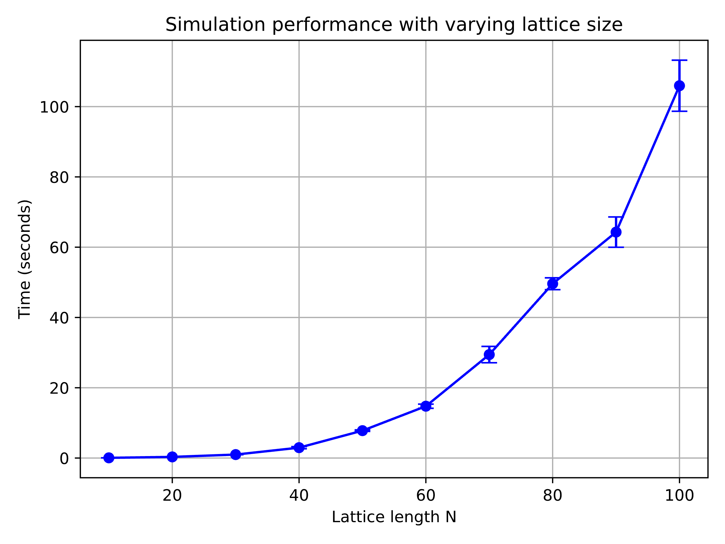
3.8 Performance: varying lattice sites

Slide 25
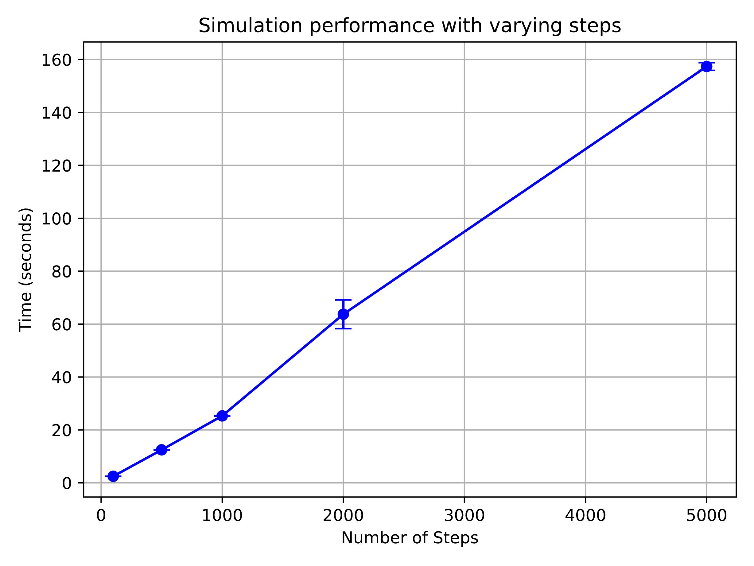
3.8 Performance: varying time steps

Slide 26
Outline
Introduction
Lotka-Volterra (LV) model: Analytical solution of exponential + logistic model
Cellular Automata (CA) simulation: Energy-based model
Mapping from exponential LV model to probabilistic CA
Conclusion

Slide 27
4.0 A probabilistic CA for predator-prey model
To reconcile the LV model with our CA approach, we investigate a probabilistic CA.
Parameters of CA:
Predator death rate
Prey reproduction rate
Prey hunting success probability
Prey migration rate
Natural question: Can we map the LV parameters to the CA parameters?

Slide 28
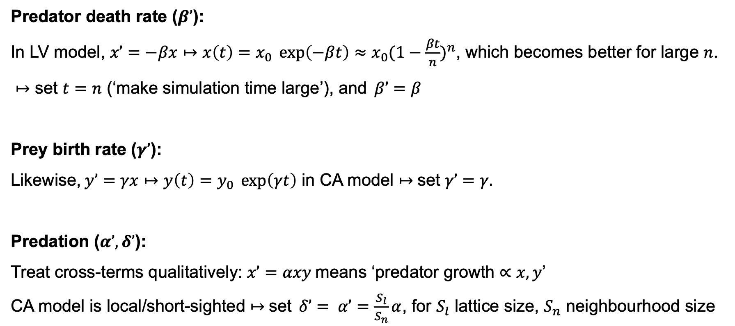
4.1 Parameter mapping LV > CA
Predator death rate ($β’$):
In LV model, $x’=−βx↦x\left(t\right)=x_{0} \exp\left(−βt\right)≈x_{0}{(1−\frac{βt}{n})}^{n}$, which becomes better for large $n$.
$↦$ set $t=n$ (‘make simulation time large’), and$β’=β$
Prey birth rate ($γ’$):
Likewise,$y’=γx↦y\left(t\right)=y_{0} \exp\left(γt\right)$ in CA model $↦$set $γ’=γ.$
Predation ($α’,δ’$):
Treat cross-terms qualitatively: $x’=αxy$means ‘predator growth $∝x, y$’
CA model is local/short-sighted $↦$set$δ’= α’=\frac{S_{l}}{S_{n}}α$, for $S_{l}$ lattice size, $S_{n}$ neighbourhood size

Slide 29
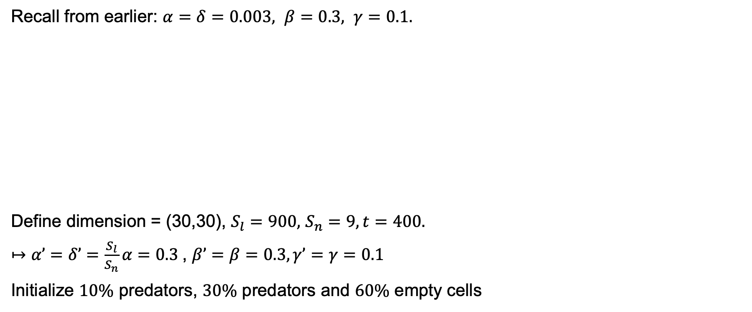
4.1 Parameter mapping LV > CA
Recall from earlier: $α=δ=0.003, β=0.3, γ=0.1.$
Define dimension = (30,30), $S_{l}=900,$ $S_{n}=9, t=400.$
$↦$ $α’=δ’=\frac{S_{l}}{S_{n}}α=0.3 \text{,} β’=β=0.3, γ’=γ=0.1$
Initialize $10\%$ predators, $30\%$ predators and $60\%$ empty cells

Slide 30
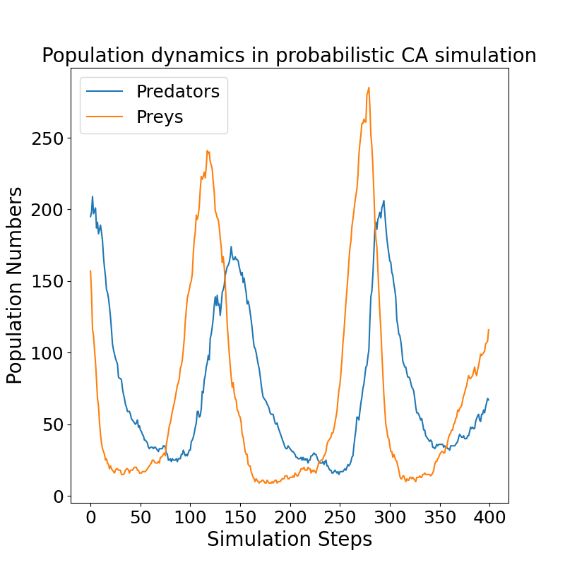
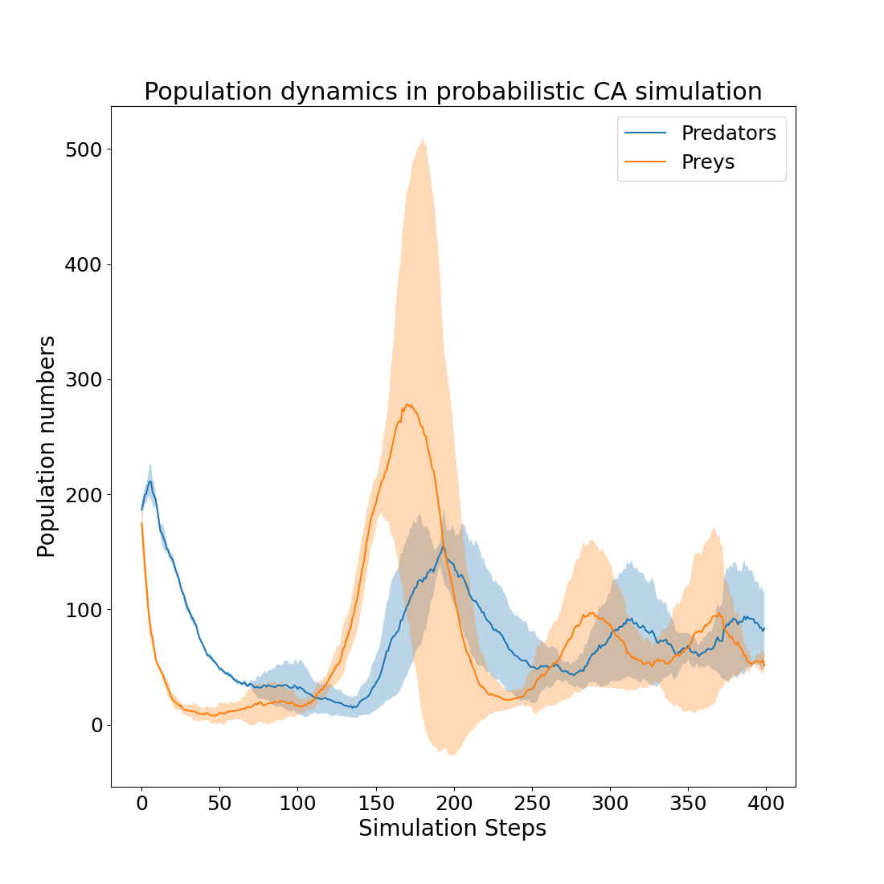
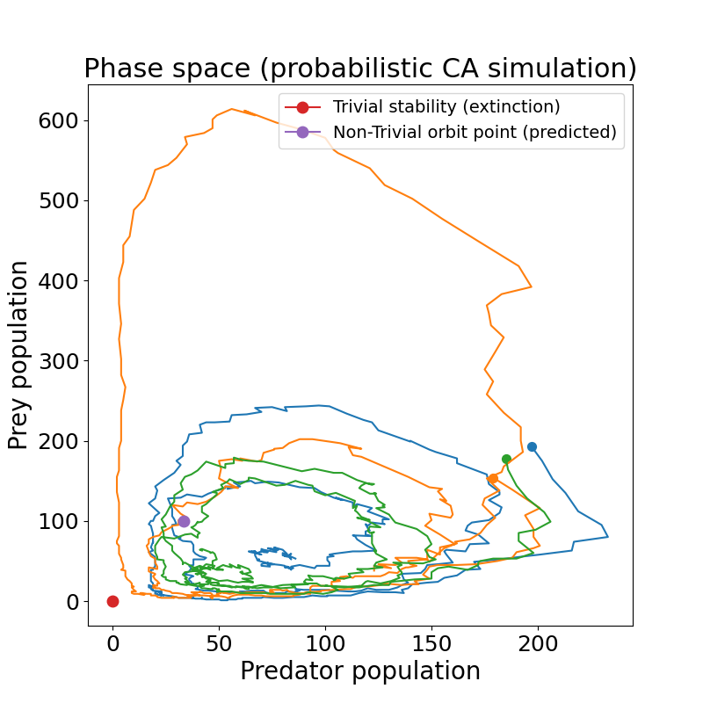
4.2 Comparison exp. LV and prob. CA model
Parameter mapping is possible!

Slide 31
Outline
Introduction
Lotka-Volterra (LV) model: Analytical solution of exponential + logistic model
Cellular Automata (CA) simulation: Energy-based model
Mapping from exponential LV model to probabilistic CA
Conclusion

Slide 32
5. Conclusion & Outlook
Both analytical and numerical methods give insight into population dynamics
Analytical methods give explainable insight into stability and bifurcations
Cellular Automata can reasonably approximate LV model, but also explore behaviours that are difficult to formulate analytically
CA simulations give insight into dynamics of predator-prey systems, and allow for evidence-based policies (environmental protection, economic viability, etc.)
What’s next?
Adding more species to the simulation
Defining more complex food chain hierarchies
Adapting more realistic reproduction behaviour
-

Slide 33
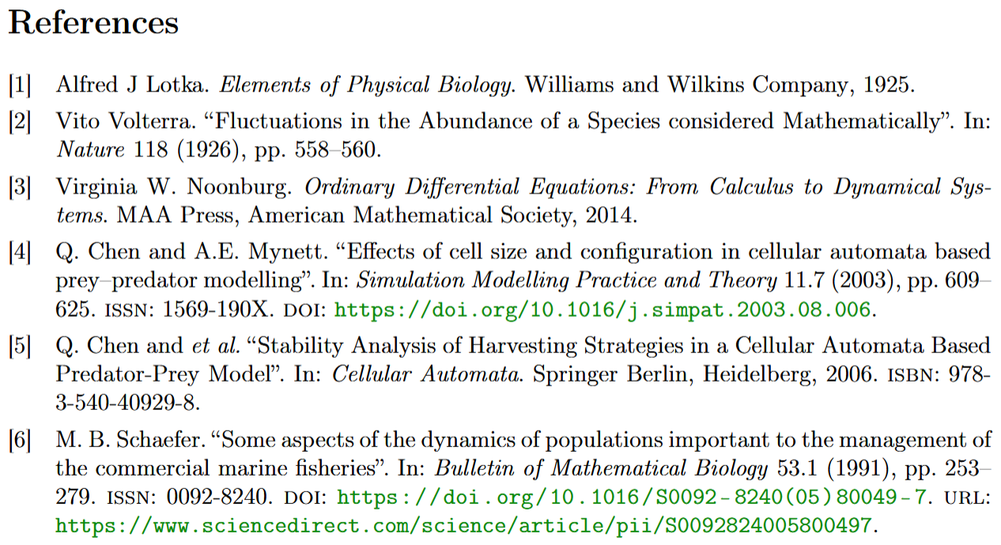

Slide 34
Afsluiter
Thank you!

Slide 35
Supplementary Slides

Slide 36
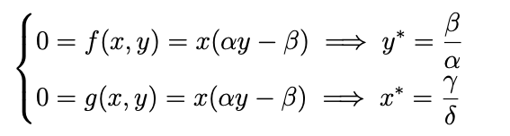
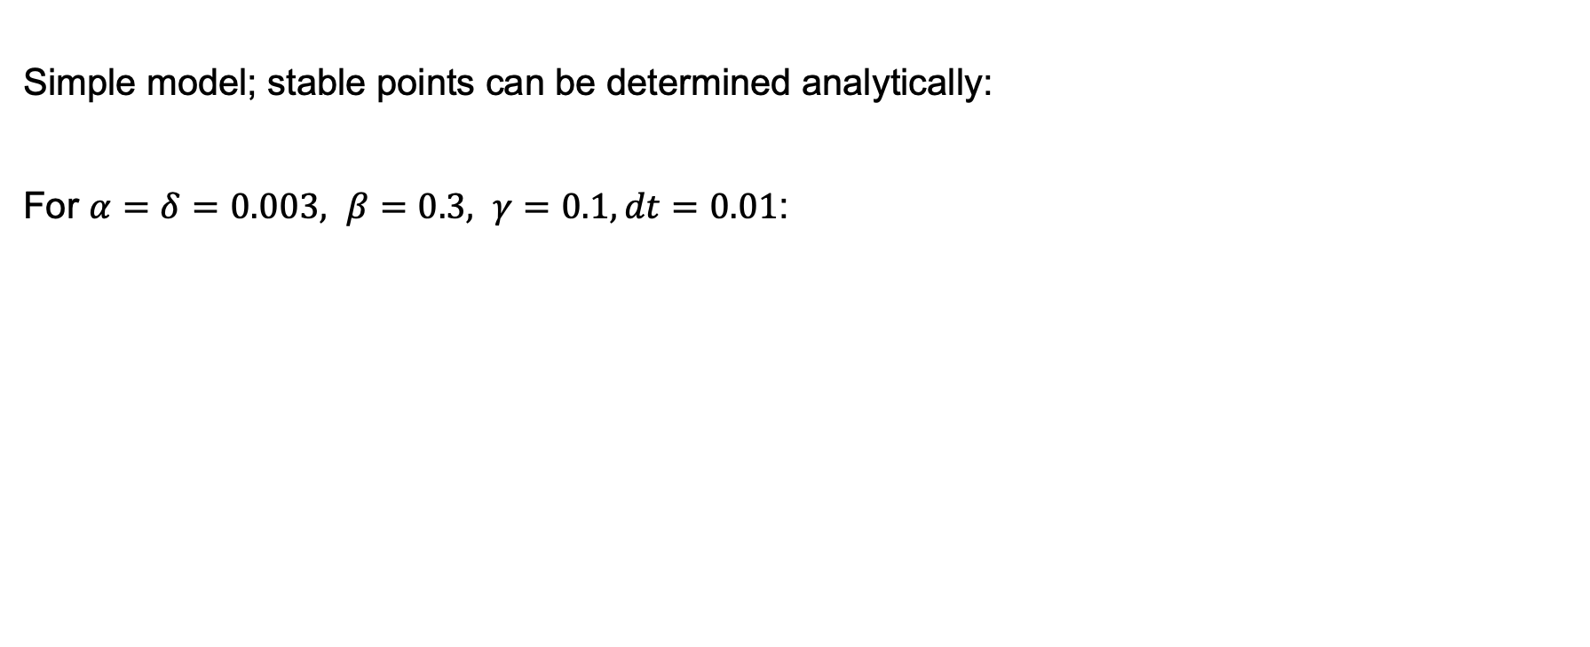
Exponential LV model
Simple model; stable points can be determined analytically:
For $α=δ=0.003, β=0.3, γ=0.1, dt=0.01$:

Slide 37
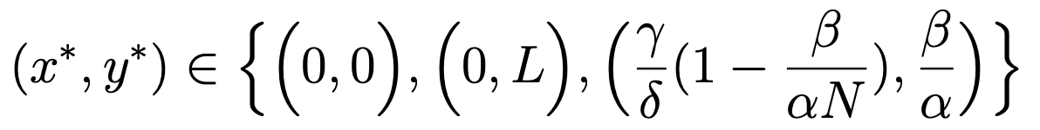
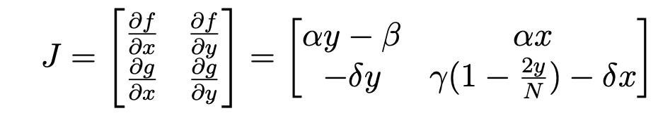
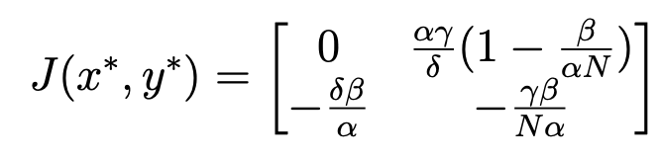
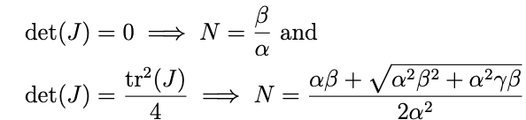
Logistic LV model
Stable points are
Bifurcation Analysis on non-trivial stable point:
Considering eigenvalues of Jacobian

Slide 38
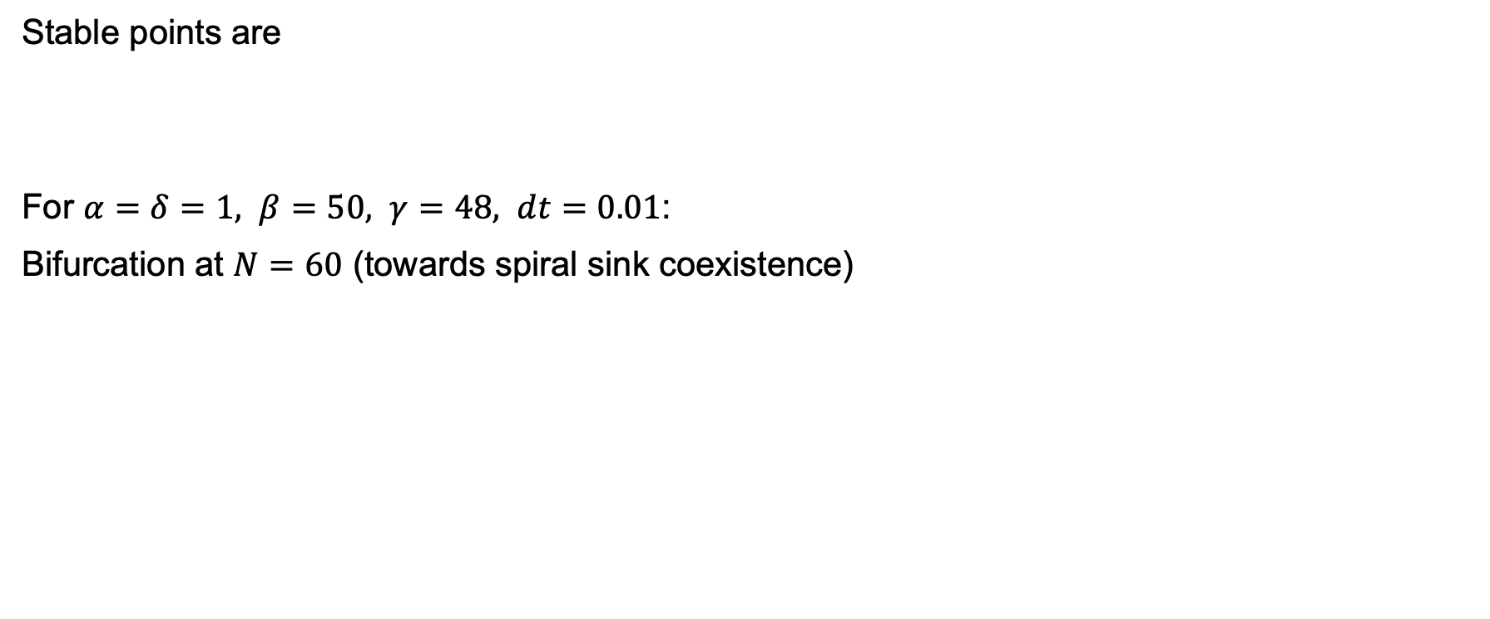
Logistic LV model
Stable points are
For $α=δ=1, β=50, γ=48, dt=0.01$:
Bifurcation at $N=60$ (towards spiral sink coexistence)

Slide 39


Probabilistic CA: migration analysis
Migration as another phenomenon that resembles reality (respecting spatio-temporal relation) which is difficult to capture analytically
Migration must be nonzero in order to observe predicted behaviour; hypothesis: we need reasonable mobility to ensure mixing and not getting stuck in local extinction, which can propagate to the entire system

Slide 40
Parameters for balanced evolution
Overpopulation: 3; Loss prey in overpopulation: 1.7
Predator's loss for moving: 2.5; Prey's gain for moving: 0.8
Loss when hunting fails: 3.2
Prey's loss when reproducing: 1.2
Minimum energy for prey's reproduction: 3.9
Minimum energy for predator's reproduction: 4.7

